Slide 1


Predicting Consumer Spending Patterns in Retail
Shadin Chatila
DSC 680 - Applied Data Science

Slide 2

Introduction
Problem Statement: Understanding and predicting consumer spending behavior
Importance: Essential for personalized marketing and maximizing sales
Audience: Retail companies, marketing teams, data analysts
Data Source: shopping_behavior.csv

Slide 3

Problem and Data Relevance
Why This Problem Matters
Data Utility
Personalized marketing increases ROI
Captures key spending factors like demographics and purchase frequency

Slide 4


Data Preparation Overview
01
Handling Missing Values
02
Removing Duplicates
03
Feature Engineering
04
Encoding Categorical Variables
05
Standardization

Slide 5
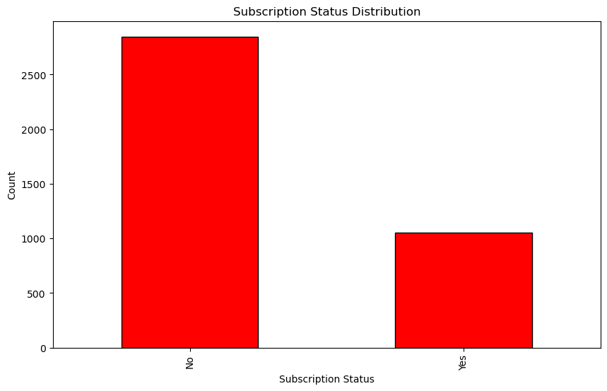
Subscription Status Distribution
01
70% of customers are unsubscribed, showing a significant opportunity for targeted marketing strategies
02
Subscribers show consistent spending habits, making them a valuable segment for retention.

Slide 6
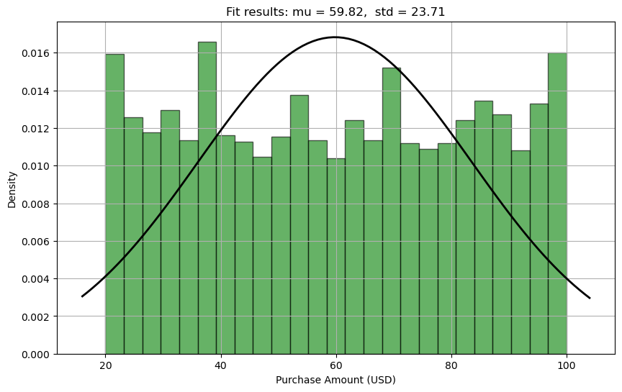
Purchase Amount Distribution With Normal Fit
01
The average purchase amount is $59.82, with significant variability across customers.
02
A standard deviation of $23.71 highlights opportunities to identify high-value segments.

Slide 7


Model Building - Linear Regression
01.
02.
03.
04.
05.
Data Preparation
Feature Selection
Data
Splitting
Linear Regression Model
Prediction
Output
Cleaned data by handling missing values, removing duplicates, and standardizing features for consistency.
Selected key variables like age and purchase frequency to enhance model performance.
Split data into 80% training and 20% testing sets to ensure reliable model evaluation.
Built a simple yet interpretable model to predict purchase amounts based on selected features.
MSE: 1.35, R-squared: 0.38. Used predictions to guide marketing strategies.

Slide 8

Results Interpretation
01.
02.
Key Predictors
Model Performance
Age and purchase frequency are key predictors of spending behavior.
The model explains 38% of the variance in purchase amounts (R² = 0.38).
03.
04.
Improvement Opportunities
Limitations
Opportunities to improve: Consider adding more features or using advanced models.
External factors like economic trends or seasonality were not included and may impact results

Slide 9
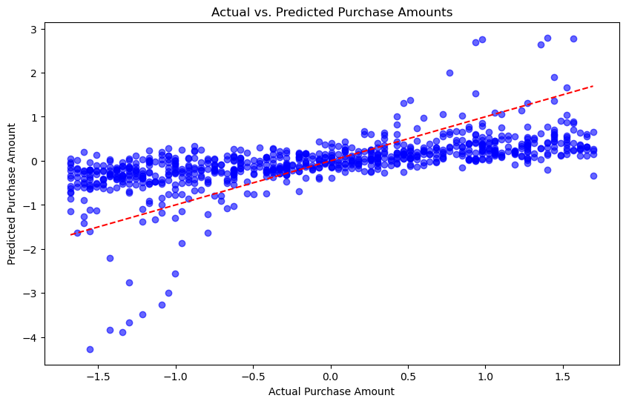
Actual VS Predicted Purchase Amounts
01
Scatterplot highlights the model's ability to predict general trends in purchase amounts..
02
Some variance suggests room for improvement with additional features or advanced models

Slide 10
01.
03.
Key Takeaways
Model Limitations
Demographics and purchase behavior significantly influence spending patterns
Expanding the model to include more features, like income level or product categories.
Conclusion
02.
04.
Marketing Strategy
Next Steps
Implement personalized marketing based on age and purchase frequency
Explore more complex models (e.g., decision trees or random forests) for improved performance.

Slide 11

Thank you!
This concludes my presentation on predicting consumer spending patterns in retail.

